Slide 1


Slide 2
Overview
Epoch of Reionization: What it is and how it fits into the bigger picture.
Galaxies + Reionization: How galaxies and the evolution of ionized hydrogen are intertwined.
My work: How I’ve explored the interplay using the escape fraction.

Slide 3
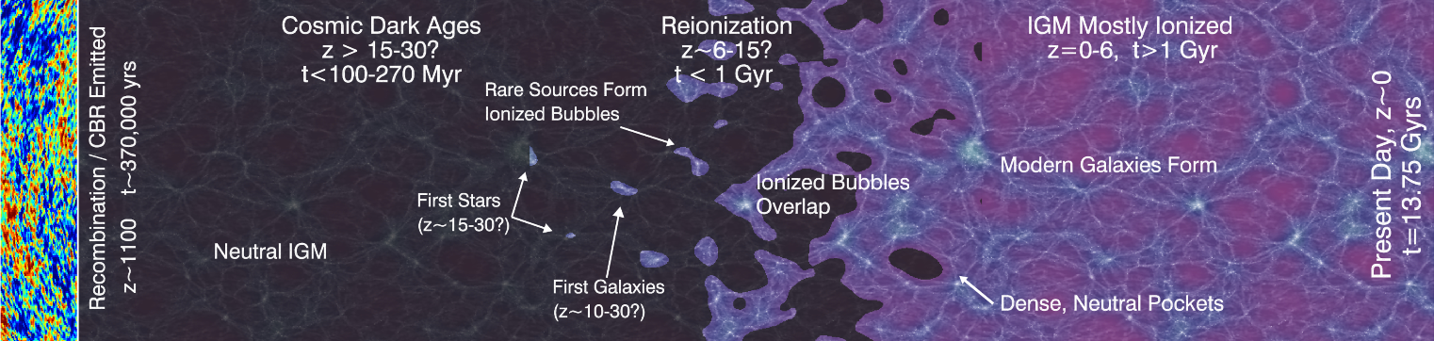
Epoch of Reionization
(Robertson, 2010)

Slide 4

IGM
IGM
IGM
IGM

Slide 5
Matter Infalls
IGM
IGM
IGM
IGM

Slide 6
Matter Infalls
Photons Emitted
𝜸
𝜸
IGM
IGM
𝜸
IGM
IGM
𝜸
𝜸

Slide 7

IGM Temp Increased
Matter Infalls
Photons Emitted
𝜸
𝜸
IGM
IGM
𝜸
IGM
IGM
𝜸
𝜸

Slide 8
(e.g. Shapiro+ 1994, Gnedin 2000, Sobacchi & Mesinger 2013)
IGM Temp Increased
Future Infall Reduced
Matter Infalls
Photons Emitted
𝜸
IGM
IGM
IGM
IGM
𝜸

Slide 9
(e.g. Shapiro+ 1994, Gnedin 2000, Sobacchi & Mesinger 2013)
IGM Temp Increased
Future Infall Reduced
Matter Infalls
Photons Emitted
𝜸
IGM
IGM
IGM
IGM
𝜸

Slide 10
(e.g. Shapiro+ 1994, Gnedin 2000, Sobacchi & Mesinger 2013)
IGM Temp Increased
Future Infall Reduced
Matter Infalls
Photons Emitted
𝜸
IGM
IGM
IGM
IGM
𝜸

Slide 11
f_{esc} Measurements
At high redshift IGM opacity prevents direct measurement of f_{esc}. Need to use low-z.
z < 1.5: f_{esc} 0-5% (Cowie+ 2009, Grimes+ 2009, Siana+ 2010)
z ~ 4: f_{esc} < 10-20% (Vanzella+ 2010, Boutsia+ 2011)
But still loads of disagreement! Some results get measurements > 20%! (Vanzella+ 2016, Guata+ 2016, Grazian+ 2016)
During EoR current requirements are f_{esc}~20%.
Notes:
Paper is the DRAGONS paper III that studied the morphology of reionization under different scenarios. “Reionization morphology at fixed neutral fraction is not uniquely determined by details of galaxy formation but is sensitive to the mass of haloes hosting the bulk of the ionizing photons.”
Also mention that current observations place fesc at levels from abount 0-10% for about z < 1.5. At higher redshift these then range from 10-20%.

Slide 12
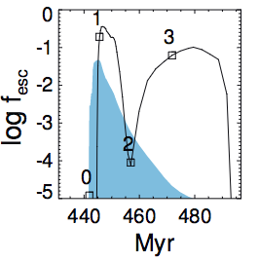
f_{esc} Depends On Galaxy Processes
Stellar feedback + supernovae blowouts move gas to outskirts.
Photons can more easily escape into the IGM.
SN Blowout
Radiation Feedback
(Kimm et al., 2017)
Notes:
From zoom-in simulations that also included a sub-grid model of SFR.
M_Part approx 1000 Msun, L approx 4 h^-1Mpc. Spatial res approx 10pc.
These images show the most massive galaxy from a number of different runs. Highlights that there is significant variation in the escape fraction over time and that there is a slight delay between the peaks in SFR and the peaks in fesc.

Slide 13
My Aim
Model the interplay between galaxies and the evolution of ionized hydrogen.
How does the topology change?
How does the duration change?
Can we observationally detect the effects?

Slide 14
Takes Two To Tango
Evolve a galaxy population through cosmic time.
Need to track their properties for f_{esc}.
Needs to be quick so we can test the effects of supernova/AGN/etc feedback.
Simulate the evolution of neutral hydrogen.
Needs to be quick so we can test different f_{esc} choices.
Notes:
Normally people just assume constant escape fraction, however this simiplifies a lot of things (as we just saw). As a consequence, are we able to determine a more physical form of the escape fraction that still agrees with general EoR things?

Slide 15
Semi-Analytic Models
Cold Gas
Star Formation
Cooling
Supernovae Heating
Incorporation
Hot Gas
Ejected Gas
Supernovae Ejection
+ Black Hole Growth
+ Merger/Disruption Events
+ Bulge Growth
Infalling Gas
Notes:
Give an overview of how SAMs work. “SAMs work by moving mass through different reservoirs depending upon coupled DEs. The processes are (e.g. supernovas heat cold gas etc etc).”

Slide 16
Supernova Feedback
Snapshot 30
Snapshot 31
Notes:
Normally people just assume constant escape fraction, however this simiplifies a lot of things (as we just saw). As a consequence, are we able to determine a more physical form of the escape fraction that still agrees with general EoR things?

Slide 17
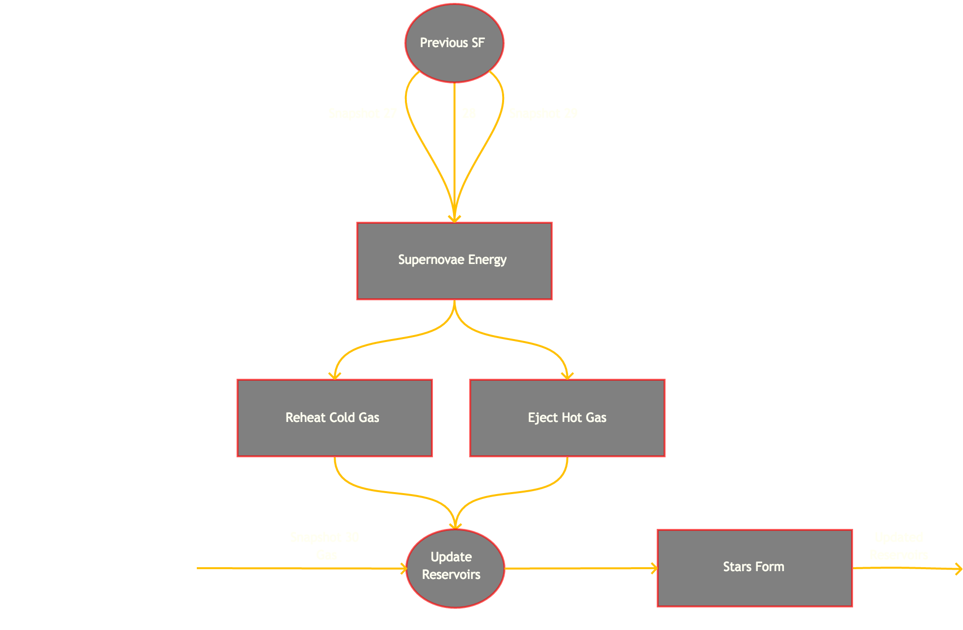
Based on Mutch+ (2016)
Notes:
Normally people just assume constant escape fraction, however this simiplifies a lot of things (as we just saw). As a consequence, are we able to determine a more physical form of the escape fraction that still agrees with general EoR things?

Slide 18
Based on Mutch+ (2016)
Notes:
Normally people just assume constant escape fraction, however this simiplifies a lot of things (as we just saw). As a consequence, are we able to determine a more physical form of the escape fraction that still agrees with general EoR things?

Slide 19
Based on Mutch+ (2016)
Notes:
Normally people just assume constant escape fraction, however this simiplifies a lot of things (as we just saw). As a consequence, are we able to determine a more physical form of the escape fraction that still agrees with general EoR things?

Slide 20


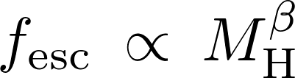




Escape Fraction Parameterization
Sample Text

Slide 21
Ionizing Photons
Bouwens+ (2016)

Slide 22
Modelling Reionization
0
0
0
0
1e52
1e51
0
0
0
0
0
9e51
Draw spheres and count the number of ionizing photons + neutral H + recombinations.
0
0
0
1e52
1e52
0
0
0
1e52
0
0
1e52
0
0
0
2e52
0
0
0
7e51
0
0
0
0

Slide 23
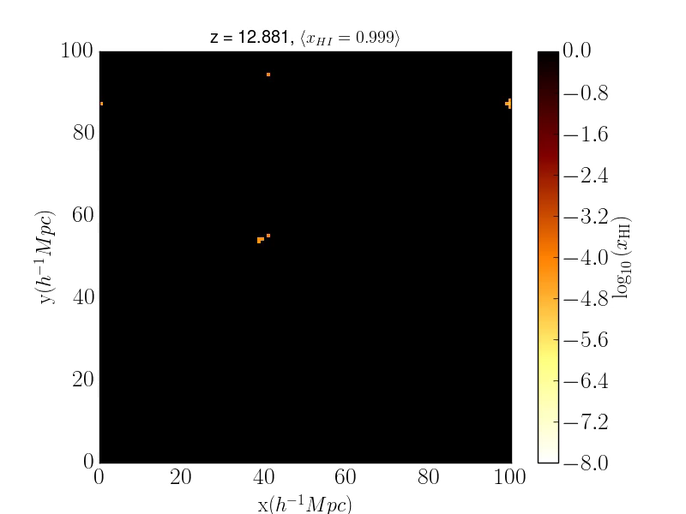
Modelling Reionization
Notes:
A previous talk has hopefully talked about SAMs; if they haven’t give a brief description. On the left is the SMF which we can see agrees to an acceptable level with the observations. On the right we see that the rate of ionizing photons reaches a plateau after ~5 Myr. This is a linear relationship that depends upon the SFR which is how we determine the number of ionizing photons emitted by each galaxy.
Finally highlight that SAMs take a short amount of time to run; easy to explore parameter space!

Slide 24
Modelling Reionization
f_{esc} Constant
f_{esc}
Halo Mass⁻¹
f_{esc}
Ejected Frac
<x_{HI}> = 0.75
<x_{HI}> = 0.50
<x_{HI}> = 0.25
Notes:
Link back to observations. Explain contours properly. What we do and don’t know about obs

Slide 25
The Next 12 Months
Quantify the difference between morphology + duration of reionization for different f_{esc} prescriptions.
Paper 1: “Morphology of ionized regions under various escape fraction parameterizations”.
Turn our results into observables (21cm signal) that telescopes can measure.
Couple the semi-analytic model with the reionization model to account for reduced matter infall.
Notes:
Basically just read the slide and give a summary. Ez pz.

Slide 26
Timeline
August 2017: Mid-candidature review
August 2017: Finalize N-body simulation and construct merger trees
September-October 2017: Initial comparison for different escape fraction prescriptions
Submit first paper
September-December 2017: Use g2 computational time to run suite of simulations
Preparation of second paper
February 2018: Second paper submission
March 2018: Third paper preparation
August 2018: Pre-submission review
October 2018: Third paper submission
February 2019: Thesis submission.

